Slide 1



Dynamic Causal Modelling of Resting-State fMRI to Predict Ketamine Response in Major Depressive Disorder
227-0973-00L: Translational Neuromodeling (Spring Semester 2025)
Project Group 8: Keyshav Mor, Rico-Marcel Benning, Leòn Schönleber
Tuesday, June 3, 2025

Slide 2
Content
Motivation
Related Work
DCMs for Depression
Generative Embeddings
Results of Prediction Tasks
Strengths & Weaknesses
Future Work

Slide 3

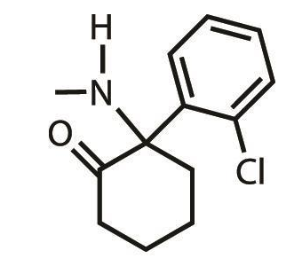
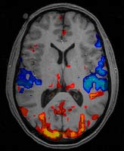
Motivation
Major Depressive Disorder (MDD) is a common psychological disorder
Effective treatment is still a challenge
Anti-depressants (SSRI, SNRI etc.) show effect in 2 - 4 weeks [1,2]
No reliable way to estimate efficacy of medical treatment
Finding the right medication for a patient with MDD can be a long, iterative process.
Ketamine (C₁₃H₁₆ClNO) has been studied by scientists as a potential anti-depressant
Ketamine Mechanism of Action Study [3,4] is one such example
Studies effects on MDD patients after a few days of Ketamine infusion (~2 to 10 days)
Problem Statement:
Estimate efficacy of Ketamine Infusion treatment on MDD patients from Ketamine study [3,4]
No information about the patients available except baseline (b0) fMRI scans
Solution: Perform DCM Generative Modeling on patients’ baseline fMRI scans
Goal:
Use connectivity parameter estimates from DCMs as generative embeddings
Use generative embeddings to identify treatment responders from non-responder
Predict treatment response levels in patients using generative embeddings
Source: Johns Hopkins University
Ketamine Molecular Structure
(Source: Chemistry World)
An fMRI scan (Source: Open University)

Slide 4
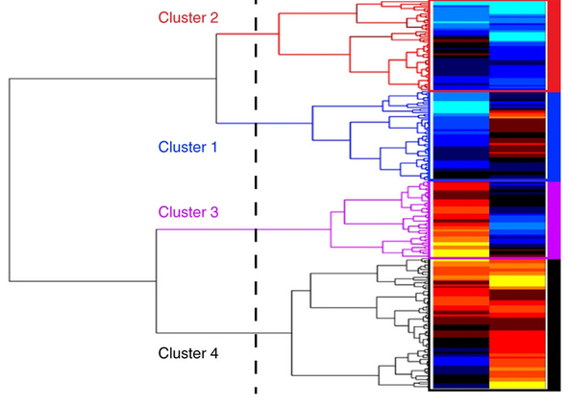
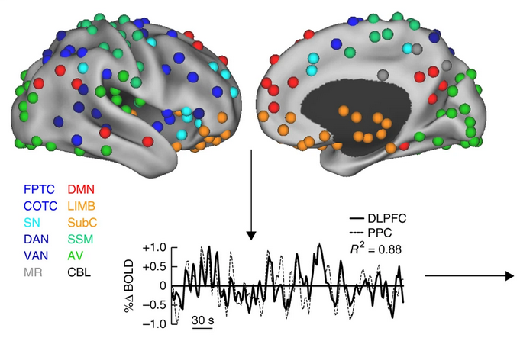
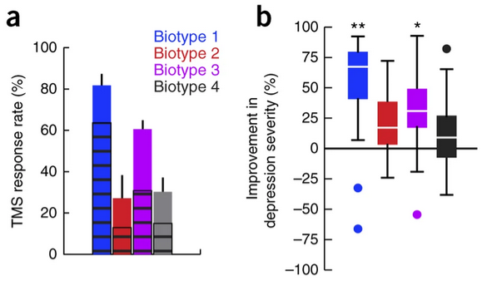
rsfMRI Data Holds Information About Treatment Response
Drysdale et al., 2016, nature med.

Slide 5
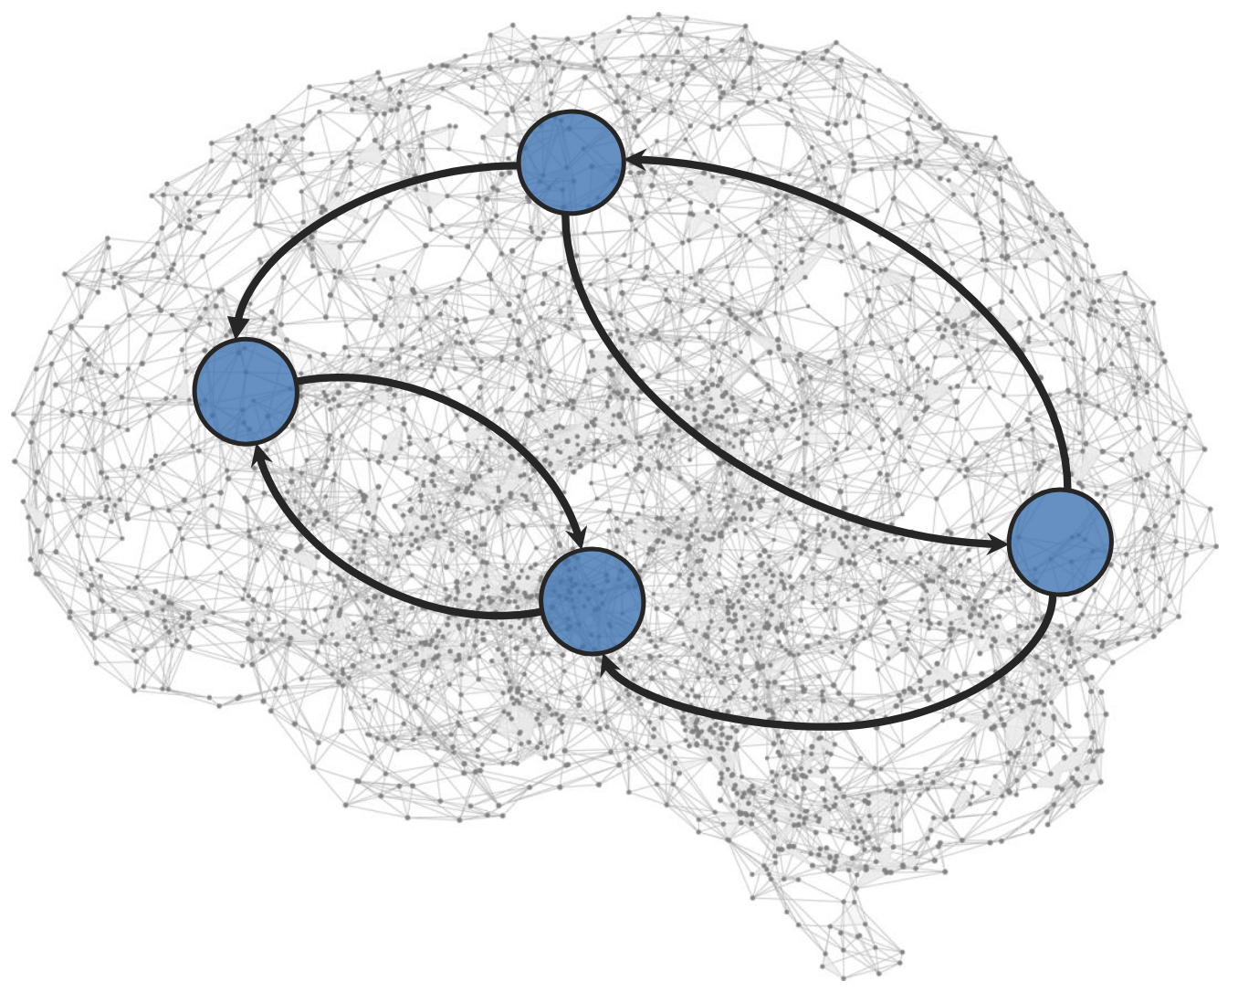
Dynamic Causal Modeling (DCM)
A forward (generative) model of
how hidden neuronal states influence each other and
how these neuronal states produce the observed data (fMRI)
After specifying the brain regions (nodes) and which connections are allowed:
the model is fit (via Bayesian inversion) to the data,
This yields posterior estimates of effective connection strengths.
For task‐free data, a stochastic term is added to capture endogenous neuronal fluctuations
Spectral DCM operates in the frequency domain
fits cross‐spectral densities rather than raw time series
makes the model inversion more computationally efficient
Friston et al., 2003, NeuroImage

Slide 6
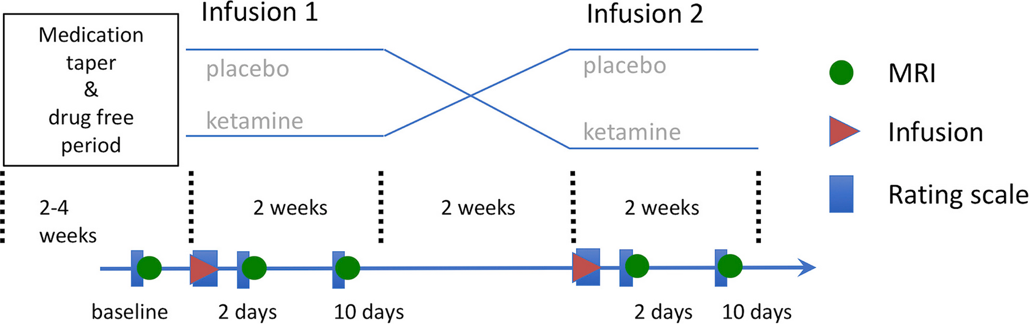
The Dataset
26 participants with MDD | 18 healthy controls
Randomized to first receive saline or ketamine infusion
8 minutes task-free fMRI
scans & assessments (MADRS) at baseline and 2 and 10 days after the infusions
Can Baseline fMRI data predict response at 2 days post ketamine infusion?
Evan et al., 2018, Biol. Psy.

Slide 7
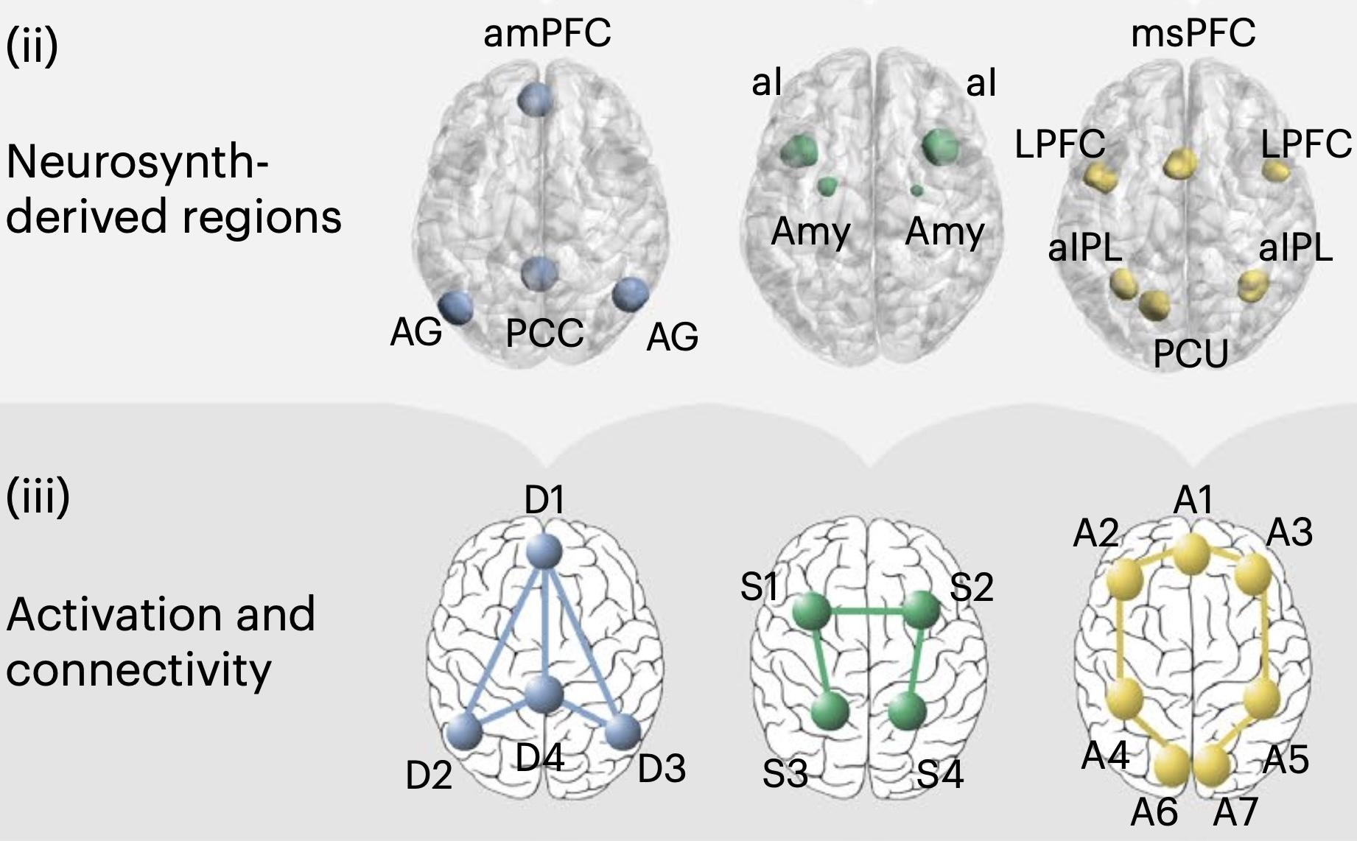
Brain Regions Relevant for Depression
MDD is associated with alterations in the following brain networks:
Default Mode Network (DMN)
Salience Network (SN)
Attention Network (AN)
(AN = frontoparietal attention circuit)
Tozzi et al., 2024, nature med.

Slide 8
Brain Regions Implicated in Ketamine’s
Antidepressant Mechanism
Next to its primary effect as NMDA receptor antagonist –
Ketamine has been shown to:
stimulate BDNF release and or expression in the
medial prefrontal cortex (mPFC) and hippocampus
induce Endocannabinoid release. Increased amounts of endocannabinoid receptor CB1 are
found in the hippocampus, amygdala and prefrontal cortex
alter 5-HT1B binding in the nucleus accumbens and ventral striatum
Ketamine Molecular Structure
(Source: Chemistry World)
Notes:
Yes I know SOURCES!!!

Slide 9
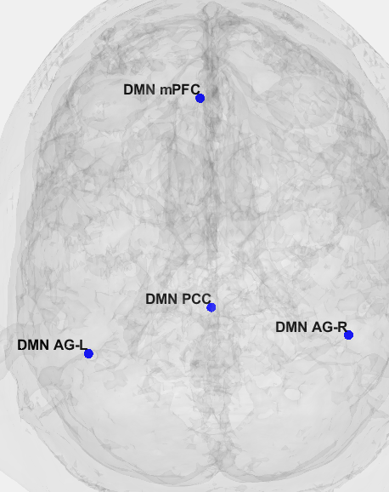
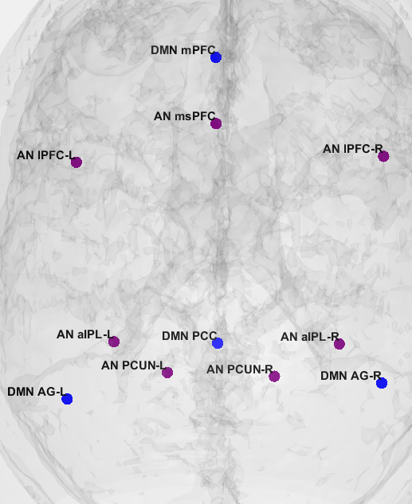
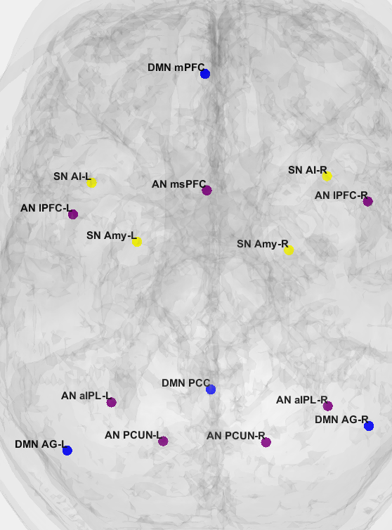
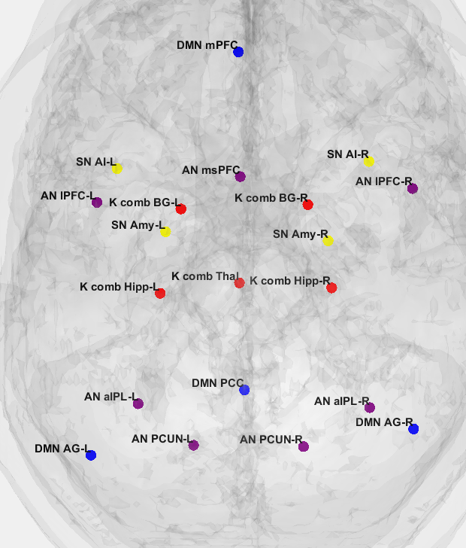
Fully Connected Spectral DCMs
4-node DCM | 11-Node DCM | 15-node DCM | 21-node DCM
DMN (blue) | DMN, AN (purple) | DMN, AN, SN (yellow) | DMN, AN, SN, Ket.rois (red)
Runtime: 1min | 20 min | 35 min | > 5 hours

Slide 10
Predictions using Generative Embeddings
Goal:
Use generative embeddings from DCMs to identify responders and non-responders (Classification)
Also predict treatment levels in patients in terms of MADRS scores (Continuous Value Regression)
Montgomery–Åsberg Depression Rating Scale (MADRS) :
0-6: Normal; 7-19: Mild Depression; 20-34: Moderate Depression; 35-60: Severe Depression
Feature Set:
16 features from 4x4 DCM; 121 features from 11x11 DCM; 225 features from 15x15 DCM
Ground Truth Target Labels:
Obtained from MADRS scores of baseline session (b0) and after 2 days (d2)
Classification Tasks: Labels hand-engineered from absolute MADRS score after session d2
Binary, Three-label, Four-label, Five-label classification validated for for the 3 DCMs
Continuous Value Prediction Tasks: Predictions on absolute d2 MADRS and delta (b0 - d2) MADRS scores
Cross Validation Strategy:
3, 4 and 5-fold cross validation for the 4 modes of classification performance validation ---> Class Imbalance Mitigation
5-fold cross validation for continuous value prediction tasks

Slide 11
Predictions using Generative Embeddings
Programming Language: Julia
MLJ.jl library in Julia supports many traditional classification and regression ML models
Models:
Classification : Logistic Regression, Multinomial Classifier, Random Forest (3, 4, 5-fold cross validation)
Continuous Value Prediction: Elastic Net Regression (L1 (Lasso) + L2 (Ridge) regularization) - 5 fold CV
Performance Evaluation Metrics:
Classification: Accuracy, F1 Score, Macro Precision, Macro Recall
Continuous Value Prediction: Mean Absolute Error (MAE), Root Mean Squared Error (RMSE)
Classification Labels Elaborated:
Binary: R (>= 25% MADRS drop); NR (<25% MADRS drop)
Three Label: NR (<=10% drop); PR (> 10% and <50% drop); Remission (>= 50% drop)
Quad Label: Deteriorating (>10% jump) Stable (<=10% jump and <=10% drop); PR (>10% and <50% drop); Remission (>=50% drop)
Five Label: Deteriorating (>10% jump); Stable (<=10% jump and <=10% drop); MR (>10% and <25% drop); SR (>=25% and <50% drop); Remission (>=50% drop)
R: Response; NR: No Response; PR: Partial Response; MR: Mild Response; SR: Strong Response

Slide 12
Predictive Embedding Classification Performance
For 3 DCM models x 3 different CV methods x 3 classification models x 4 label modes:
108 tabular results were obtained (3x3x3x4 = 108)
We only present the best Cross-Validation-Classification Model-Label Mode combo for each DCM
NaN values encountered for F1 score, Precision and Recall
Not for all but many CV-classification model-label mode combinations (non-binary classification cases)
Class imbalance issue due to small dataset (26 subjects)
Off 58 subjects, only 26 depressed patients had b0 fMRI scans and MADRS scores for b0 and d2
Fold | Accuracy | F1_Score | Precision | Recall
1 | 0.83 | 0.83 | 0.83 | 0.875
2 | 0.6 | 0.58 | 0.67 | 0.75
3 | 0.8 | 0.8 | 0.83 | 0.83
4 | 0.6 | 0.58 | 0.67 | 0.75
5 | 0.8 | 0.76 | 0.75 | 0.875
Avg | 0.73 | 0.71 | 0.75 | 0.82
Binary Classification achieves minimum 65% accuracy for all 3 DCM embeddings across 3 and 5 fold cross validation!
Fold | Accuracy | F1_Score | Precision | Recall
1 | 0.78 | 0.78 | 0.78 | 0.78
2 | 0.56 | 0.55 | 0.55 | 0.55
3 | 0.63 | 0.56 | 0.63 | 0.79
Avg | 0.65 | 0.63 | 0.65 | 0.70
Fold | Accuracy | F1_Score | Precision | Recall
1 | 0.67 | 0.625 | 0.67 | 0.8
2 | 0.6 | 0.58 | 0.58 | 0.58
3 | 0.6 | 0.58 | 0.58 | 0.58
4 | 0.8 | 0.76 | 0.75 | 0.875
5 | 0.6 | 0.58 | 0.67 | 0.75
Avg | 0.65 | 0.63 | 0.65 | 0.72
Binary Classification Performance on 4x4 DCM
Binary Classification Performance on 15x15 DCM
Binary Classification Performance on 11x11 DCM

Slide 13
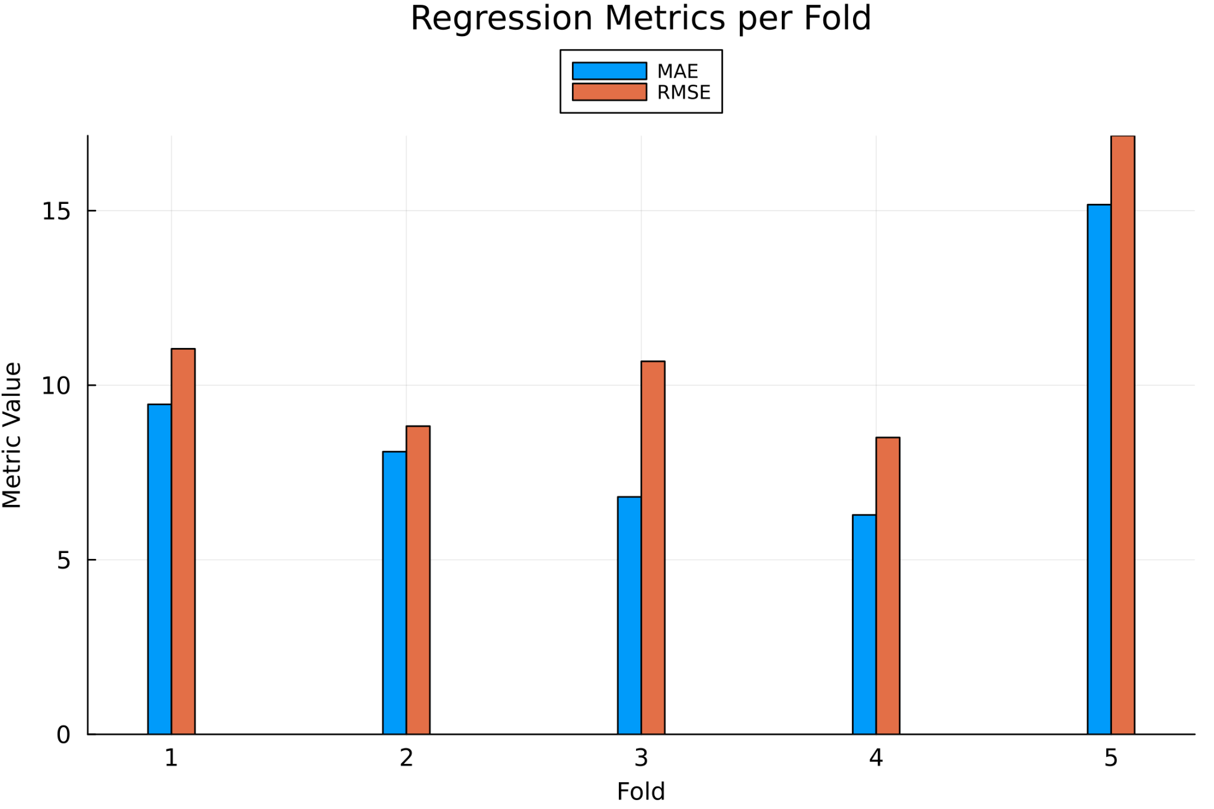
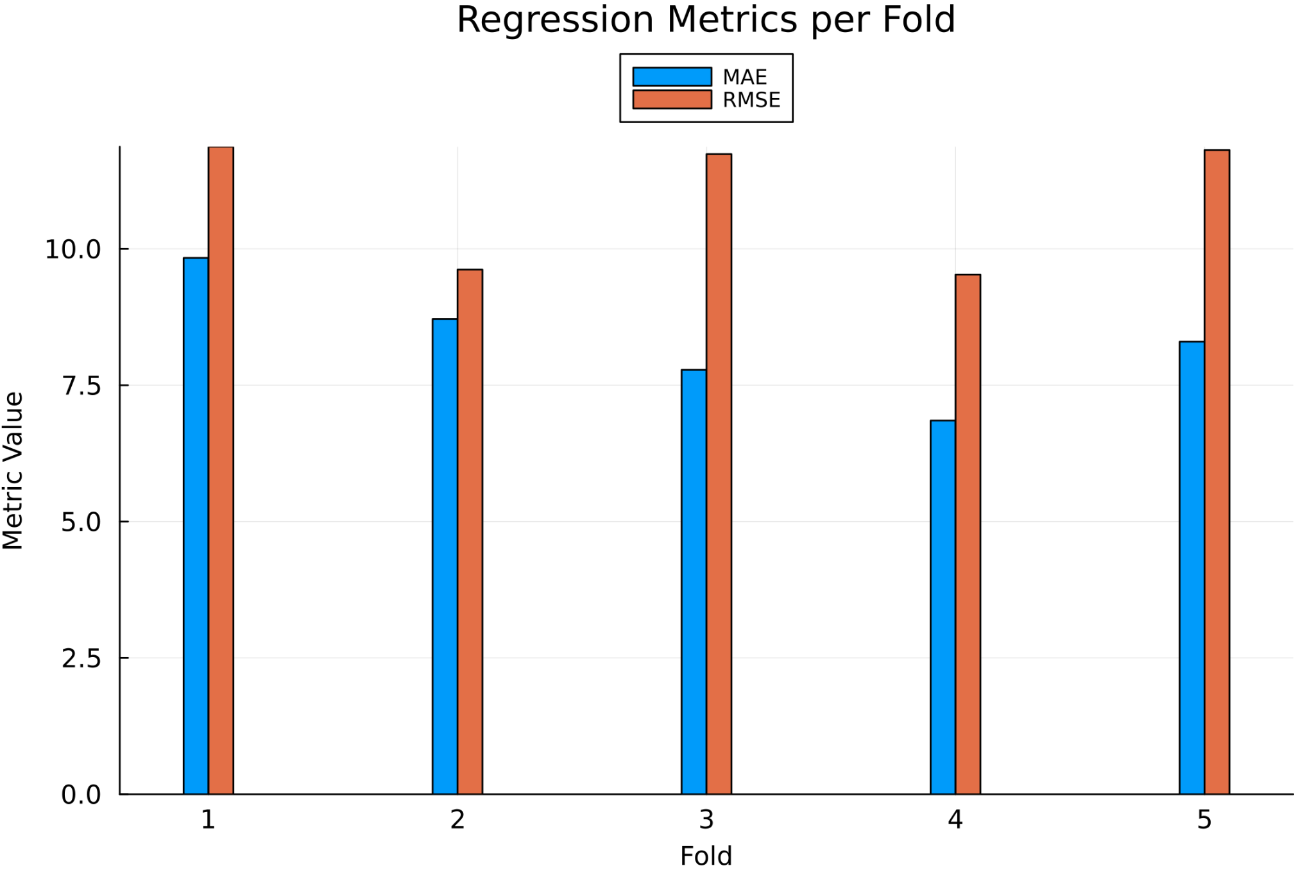
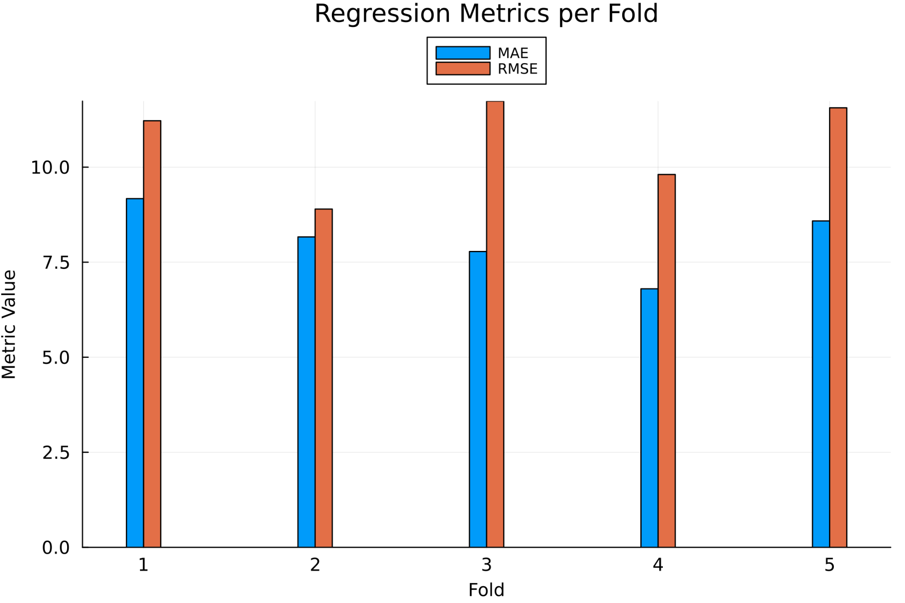
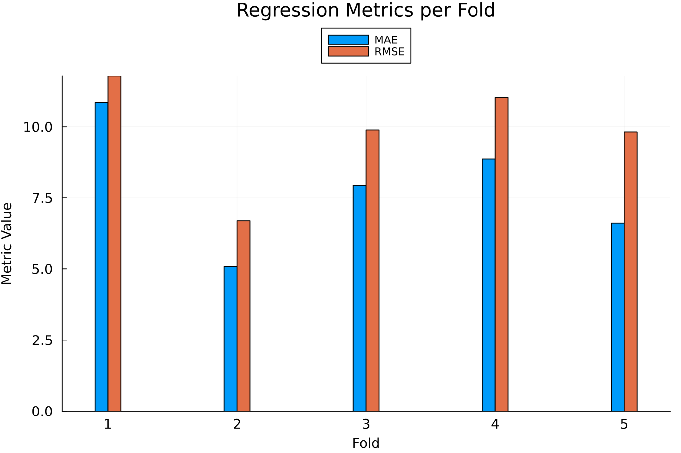
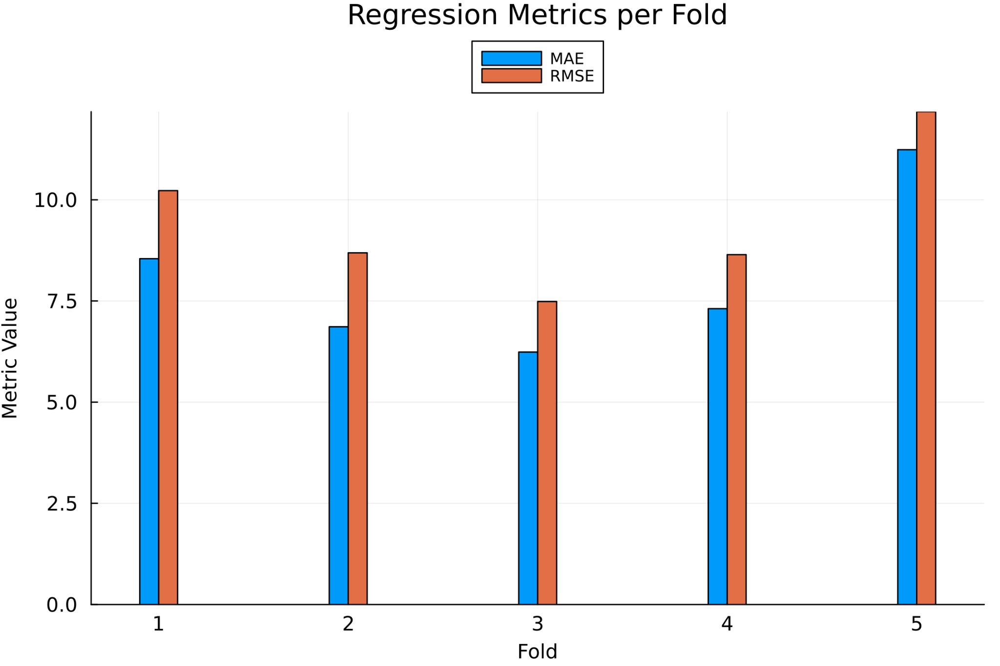
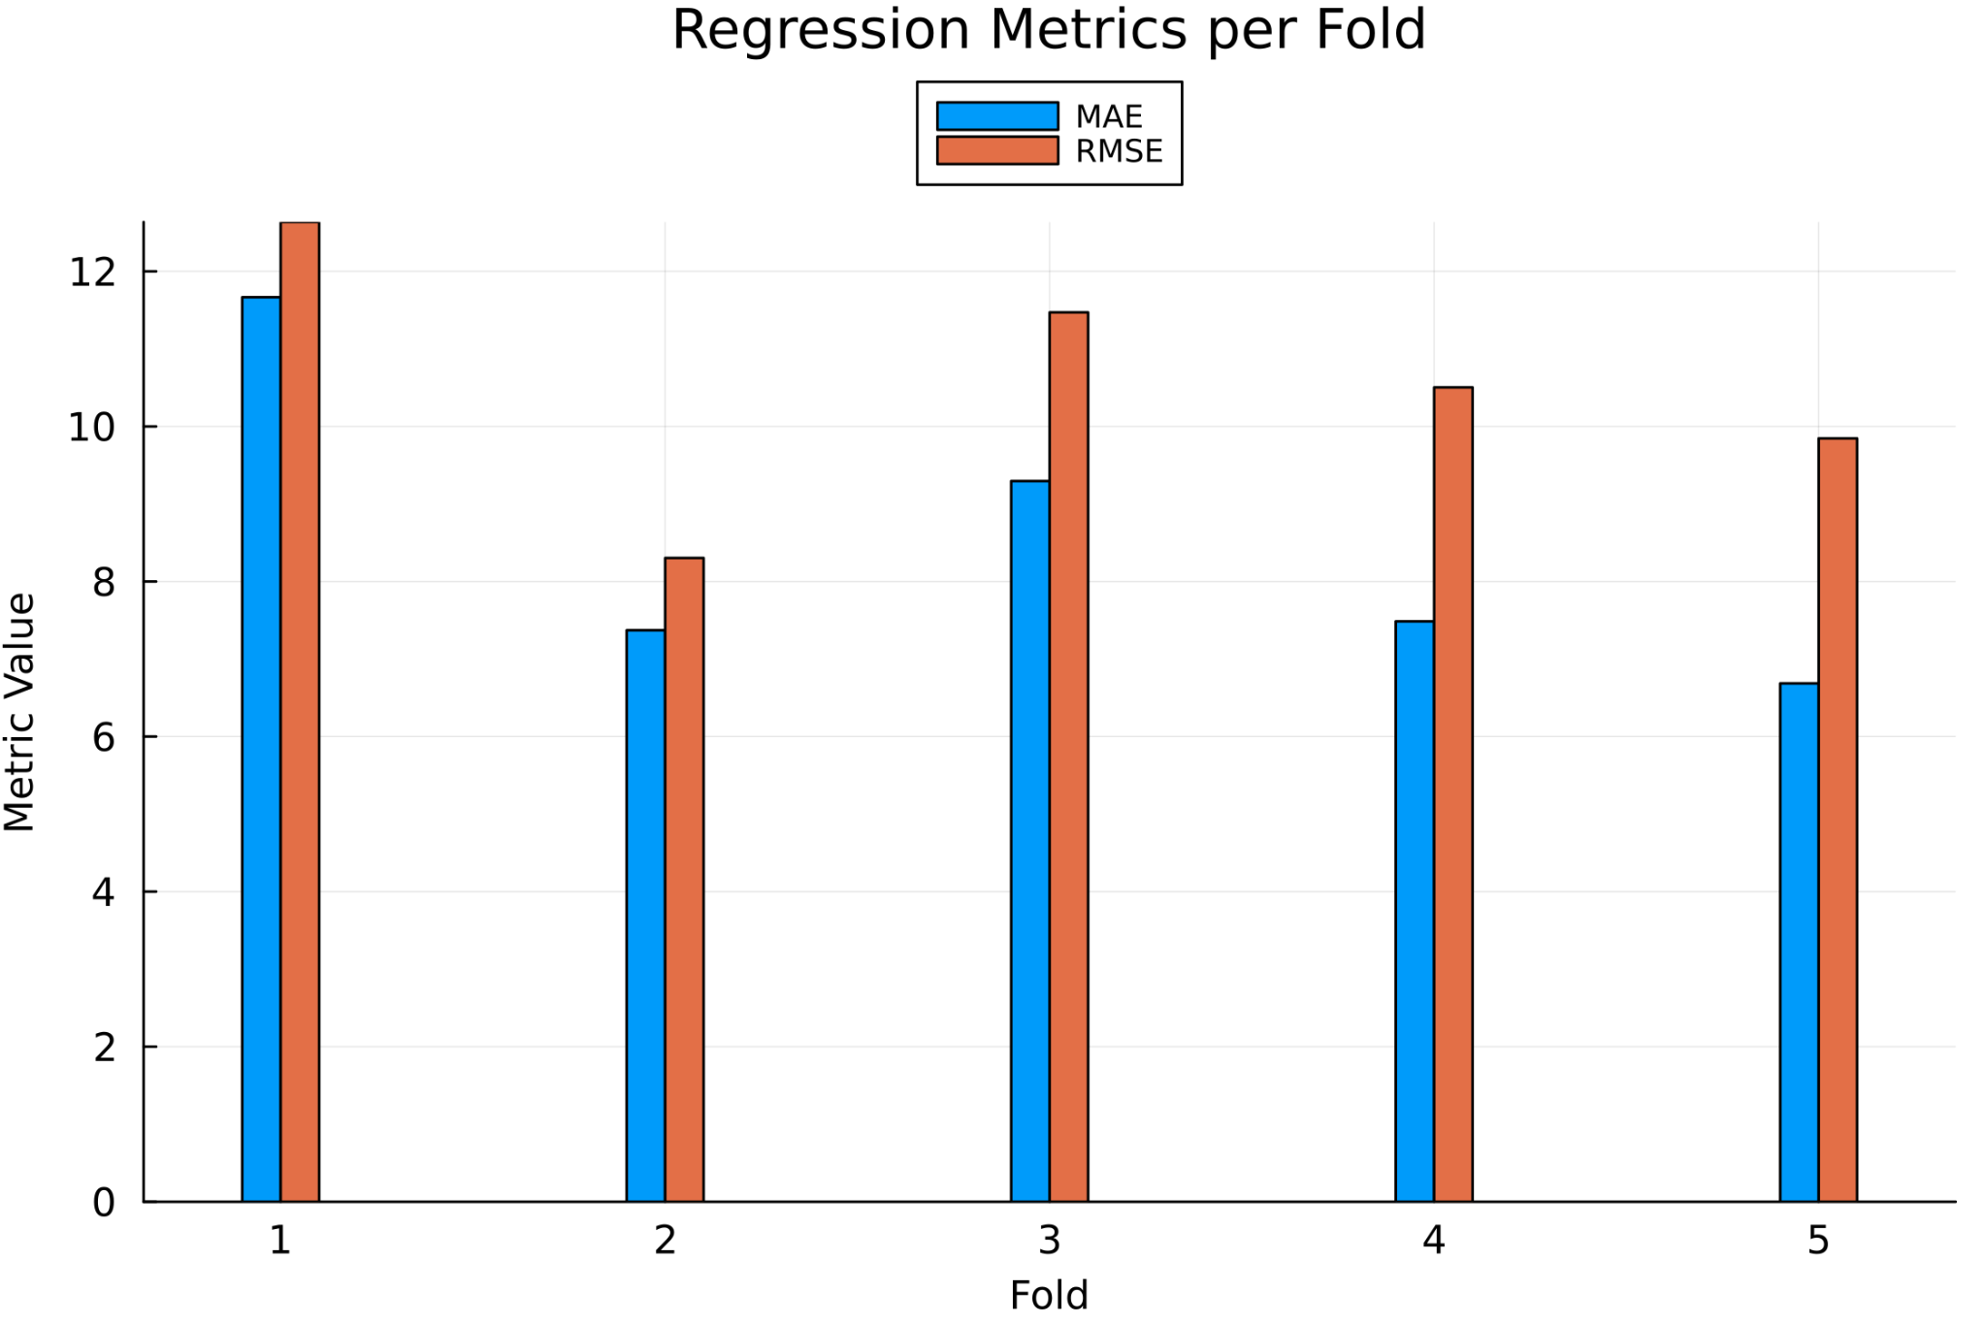
Continuous Value Prediction Performance
For 3 DCM models x 1 cross validation method x 1 regression model x 2 predictive tasks:
6 tabular results were obtained (3x3x3x4 = 108)
2 predictive tasks: predict on absolute MADRS and difference in MADRS scores (b0 - d2) 2 days post infusion
4x4 DCM 5-fold Cross-Validation Metrics on Predicting Absolute
MADRS Values
11x11 DCM 5-fold Cross-Validation Metrics on Predicting Absolute MADRS Values
15x15 DCM 5-fold Cross-Validation Metrics on Predicting Absolute MADRS Values
4x4 DCM 5-fold Cross-Validation Metrics on Predicting Delta
MADRS Values
11x11 DCM 5-fold Cross-Validation Metrics on Predicting Delta
MADRS Values
15x15 DCM 5-fold Cross-Validation Metrics on Predicting Delta MADRS Values

Slide 14
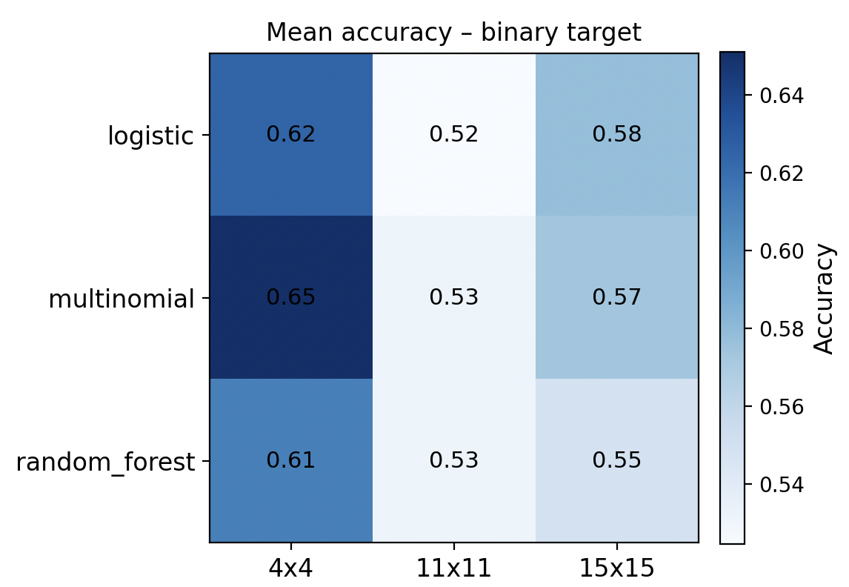
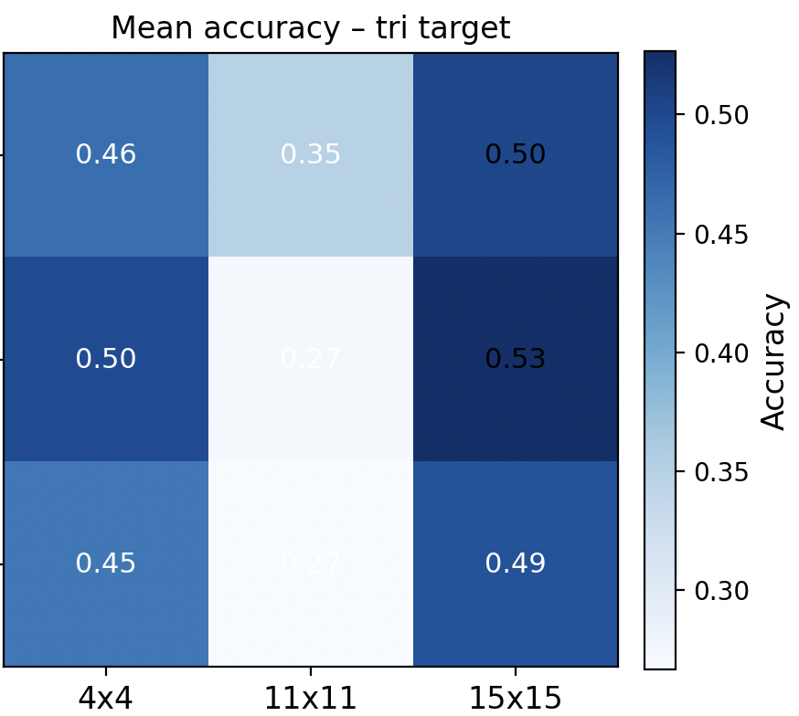
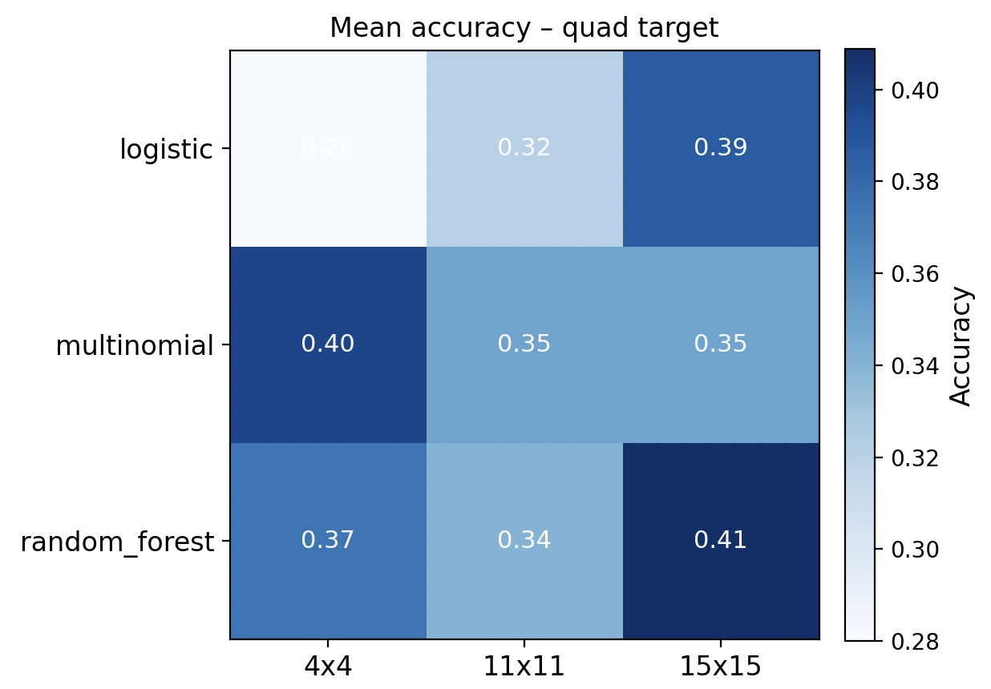
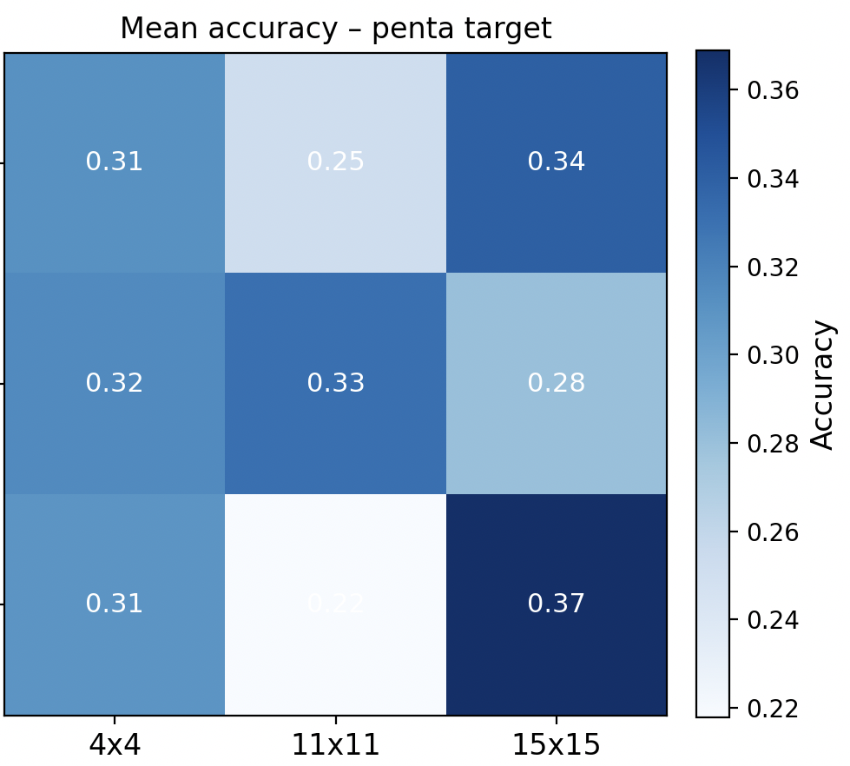

Cross-Validation Accuracy at a Glance
Rows = model families with accuracy across CV folds
Best performance: Binary classification with 4x4 DCM
Accuracy drops with larger DCMs & finer label granularity
Smaller (biologically) embeddings outperform noisier larger ones
4 Heatmaps (binary to penta-class) with mean accuracy values

Slide 15
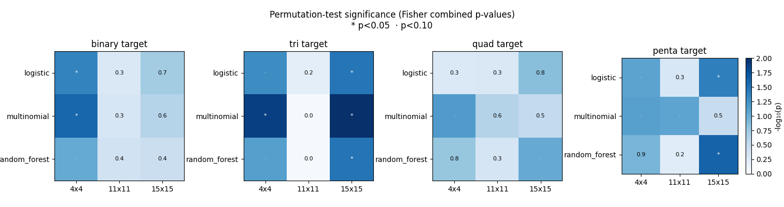
Permutation Tests: Actually Significant?
500 random label shuffles per fold → null accuracies
Significance metric: Combined p-values via Fisher’s method → heatmaps
Larger DCMs ≈ chance
Statistical validation matches intuition: The Signal lives in small networks, especially for binary labels!

Slide 16
Key Strengths of Our Findings
Clear Clinical Motivation
Distinguish ketamine responders vs. non-responders in MDD
Interpretability over complexity
4x4 DCM saw high accuracy 73% , low p-values
Efficiency & effectivity of the models generative embeddings
<1 min vs. 35 min
Single baseline scan provides immediate utility
Robust cross-validation
3-5 fold CV shows stability for the 4x4 across folds
General reproducibility!

Slide 17
Limitations and Future Work
Tiny sample size: study on 26 subjects cannot be generalised to larger groups
P-values vary wildly between folds
Class imbalance: Some classes only 1-2 samples per fold!
Unstable metrics for more nuanced classification: 3, 4, 5-label classification yield NaN values in F1 score, Precision and Recall
Overfitting in larger DCMs: Feature count explodes from 16 to 225 but observations stays the same
Models memorizes noise
Classification success sensitive to how labels are defined
Continuous Value Prediction for all DCM embeddings have poor MAE & RMSE scores
Generative embeddings do not store enough informative features to assist in such tasks
Regression models need more fine tuning to learn from these features
Future Work:
Building a bigger fMRI dataset of depressed subjects to test more nuanced classification methods
Fine-tune ElasticNet or similar models to test generative embeddings on continuous prediction tasks
Test classification & regression models with session b0 MADRS score as an additional feature

Slide 18
Where does this leave us?
Focus on compact, interpretable 4x4 embedding
Scale the cohort
Add model complexity

Slide 19
Bibliography
W. S.-N. A. W. D. R. L. N. G. H. R. L. B. M. P. S.-W. K. B. M. B. G.F. M. Trivedi MH, Rush AJ, “Evaluation of outcomes with citalopram for depression using measurement-based care in star*d: implications for clinical practice,” Am J Psychiatry, vol. 18, 2006.
J. C. J. J. D. Thomas R. Einarson, Steven R. Arikian, “Comparison of extended-release venlafaxine, selective serotonin reuptake inhibitors, and tricyclic antidepressants in the treatment of depression: A meta-analysis of randomized controlled trials,” Clinical Therapeutics, vol. 21, 1999
Jennifer W. Evans and Allison C. Nugent and Carlos A. Zarate (2025). NIMH Ketamine Mechanism of Action Study. OpenNeuro. [Dataset] doi: doi:10.18112/openneuro.ds005917.v1.0.1
Zarate, C. A., Singh, J. B., Carlson, P. J., Brutsche, N. E., Ameli, R., Luckenbaugh, D. A., Charney, D. S., & Manji, H. K. (2006). A randomized trial of an N-methyl-D-aspartate antagonist in treatment-resistant major depression. Archives of General Psychiatry, 63(8), 856–864. https://doi.org/10.1001/archpsyc.63.8.856:contentReference[oaicite:7]
Frässle S, Yao Y, Schöbi D, Aponte EA, Heinzle J, Stephan KE (2018) Generative models for clinical applications in computational psychiatry.Wiley Interdiscip Rev Cogn Sci 9(3):e1460
Galioulline H, Frässle S, Harrison SJ, Pereira I, Heinzle J, Stephan KE. Predicting future depressive episodes from resting-state fMRI with generative embedding. Neuroimage. 2023 Jun;273:119986. doi: 10.1016/j.neuroimage.2023.119986. Epub 2023 Mar 22. PMID: 36958617.

Slide 20
THANK YOU FOR YOUR ATTENTION!
Notes:
TEST

Slide 21
BACKUP SLIDES

Slide 22
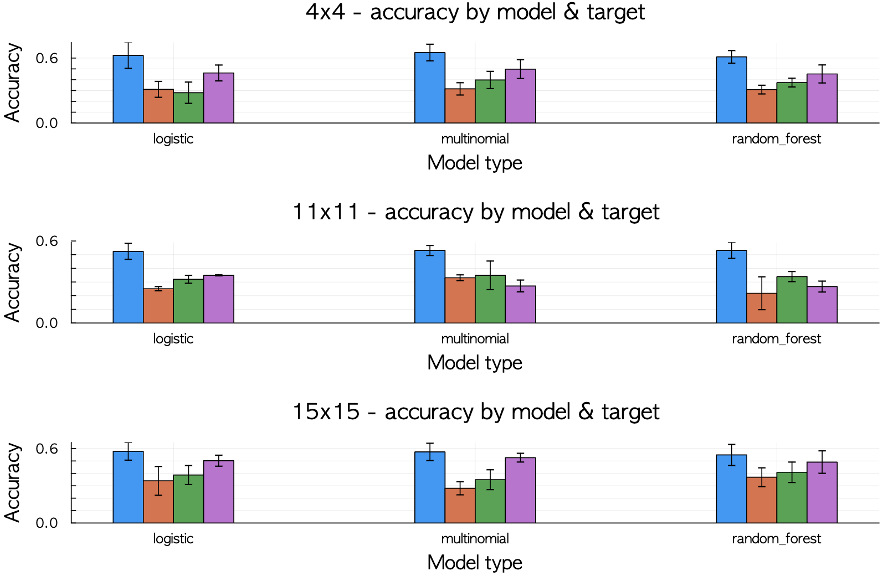

Slide 23
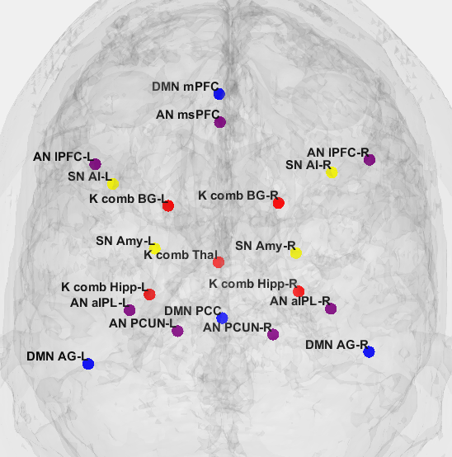
Backup
21-node DCM ROIs

Slide 24
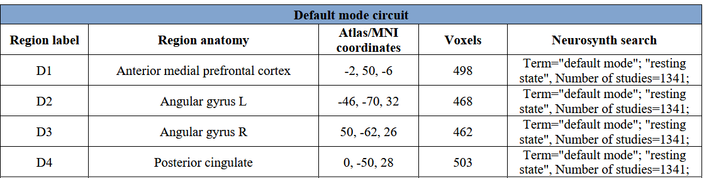
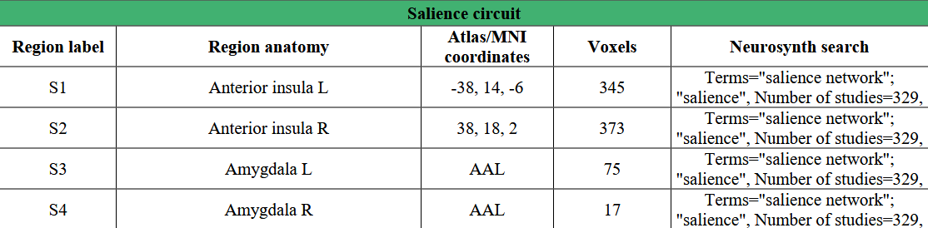
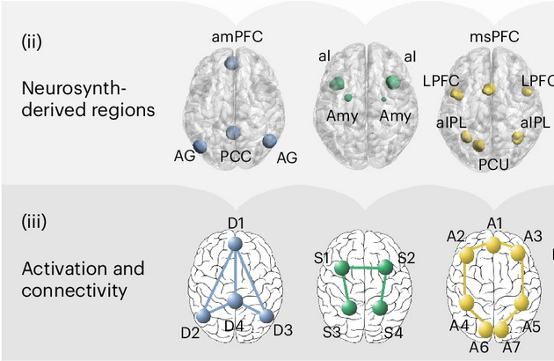

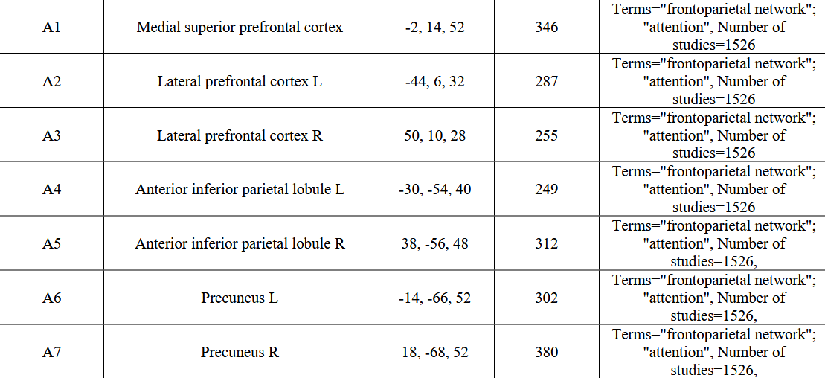
Backup Tozzi ROIs
Tozzi et al., 2024

Slide 25
Related Work & Inspirations
Related work in DCM Generative Modeling:
Stefan Frässle et. al [5] surveyed DCM modeling, its challenges and clinical applications in computational psychiatry
Galioulline et. al [6] worked on predicting future depressive states using generative embeddings from resting state fMRI
Above works inspired us to implement DCMs for fMRI to identify Ketamine treatment responders and
predict treatment response values (MADRS) scores in patients
Friston et al., 2003, NeuroImage

Slide 26
Links to All the Tables:
Regression Performance Metrics: https://drive.google.com/drive/folders/1VdrC7v95wXy2z6Y1bb0dDftFRWz5-YAv
Classification Table Metrics: https://drive.google.com/drive/folders/1feefGpBDvN_3uZFatr3RutIRNcMECsFF
Performance Figures: https://gitlab.ethz.ch/tn_projects_fs2025/Project_8/-/tree/main/Classification_and_Regression_DCM/figures?ref_type=heads

